Slide 1
D.P team
Notification of Asthma Risk Index by Region
subject name: 산학캡스톤 디자인1
professor in charge : 정 현 숙
presenter : 안 효 근
publication date : 2019 06 13
안효근
김연수
임정준
정혜수
김현구
2019/06/13

Slide 2
Notification of Asthma Risk Index by Region
Table of Contents
Team Member Introduction
development motive
Selected type of disease
Development Objectives
4-1 ) functions.
4-2 ) expectation effectiveness
-3page
-4page
-5page
-6page
-7page
-8page
5. development environment
5-1 ) Reasons for selecting
development program
5-2 ) system flow diagram
6. development process
6-1 ) development process
6-2 ) detailed explanation
7. Execution video
8. development schedule
9. References
literature and site
-9page
-10page
-12page
-14page
-15page
-16page
-54page
-55page
-56page

Slide 3






Notification of Asthma Risk Index by Region
1. Team Member Introduction
NAME | 안효근
PHONE | 010-7227-4260
EMAIL | dksgyrms1579 @naver.com
PART
NAME | 임정준
PHONE | 010-6650-7445
EMAIL | ehrn56 @naver.com
PART
NAME | 김현구
PHONE | 010-6243-3502
EMAIL | k1hq1201 @naver.com
PART
NAME | 김연수
PHONE | 010-9361-7968
EMAIL | kys79757 @naver.com
PART
NAME | 정혜수
PHONE | 010-9457-3489
EMAIL | ehdrkdeod @naver.com
PART

Slide 4
50%
CONTENTS A
Notification of Asthma Risk Index by Region
2-1. development motive
Many people now have disease-related problems.
According to airborne irritant substances such as fine dust and ozone due to environmental pollution Since respiratory illness is often cited as the cause of asthma and is a life-threatening condition, The consequences of asthma can be felt in people. The purpose of the Chapter is to inform and provide information to users in each region.

Slide 5
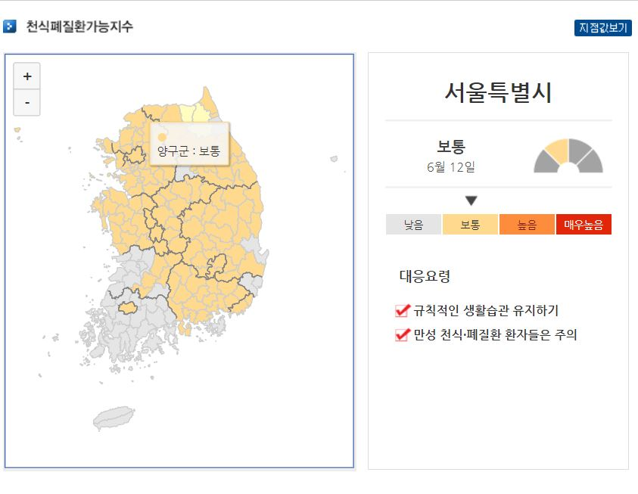
50%
CONTENTS A
Notification of Asthma Risk Index by Region
2-2. development motive
Link :
https://web.kma.go.kr/weather/lifenindustry/jisudaymap_D01.jsp

Slide 6
50%
CONTENTS A
Notification of Asthma Risk Index by Region
3. Selected type of disease
Asthma is a condition that sometimes coughs because the bronchial tubes in the lungs become very sensitive and the trachea becomes narrow. The number of patients appears to increase from February to April and decline from May.
Asthma
Prevention: Factors that have deteriorated and generated material through nvironmental management should be avoided. Symptoms (a difficulty breathing, strong wind, chest cramps, etc.) go to the hospital immediately.
Treatment method:
1. Drug treatment :1) Symptom alleviation (institutional dilatation) and 2) Disease control
2. Immunotherapy: Avoiding causes through environmental management
(continued for at least one year)

Slide 7
50%
CONTENTS A
Notification of Asthma Risk Index by Region
4. Development Objectives
4-1 ) functions.
4-2 ) expectation effectiveness

Slide 8



50%
CONTENTS A
Notification of Asthma Risk Index by Region
4-1) functions.
related to asthma
providing news
domestic asthma
Preventive information provision
Domestic. Asthma Caution

Slide 9
50%
CONTENTS A
Notification of Asthma Risk Index by Region
4-2) expectation effectiveness
By region. Asthma sufferers and young children.
Ensure asthma-prone environment.
Rapid response reduces occurrence and recurrence

Slide 10
50%
CONTENTS A
Notification of Asthma Risk Index by Region
5. development environment
5-1 ) Reasons for selecting development program
5-2 ) system flow diagram

Slide 11






Notification of Asthma Risk Index by Region
5-1-1). Reasons for selecting development program
- Operating system: Windows 10 (development)
-Used languages: Python 3.7.3
* Python is spoken by Anaconda and Pycham because they support Python.
-Save data: MySql
* When workingbench is used to check and process results immediately MariaDB was selected as mysql due to occasional errors during processing.
- Initial data analysis & processing: Anaconda (3.7ver)
* it is easy to process data with Python language. Use processed data for visualization
- Analysis of real-time data & processing: Pycharm
* It's one of the programs provided by PyCharm Python, and you can get real-time data. You can implement the web.
-Server&HTML Communication: flask
* The reason for using flask is that it has its own server and can only install necessary libraries and packages to build a framework.
1 | 2 | 3
Windows 10 | Python 3.7.3 | Mysql 8.0.10
4 | 5 | 6
Anaconda3.7 | Pycharm 64bit | flask
The reason why we chose an anaconda is because
Notes:
-운영체제 : 윈도우 10(개발)
-사용언어 : 파이썬 3.7.3
* 사용언어를 파이썬으로 한 것은 아나콘다와 파이참이 파이썬 언어를 지원하기 때문에
파이썬으로 선택하였음.
-초기 데이터 분석&가공 : 아나콘다(3.7ver)
* 아나콘다를 선택한 이유는 파이썬 언어와 함께 데이터의 분석 가공이 용이하고
처리된 데이터를 시각화로써 보기 편하여 사용
-실시산 데이터 분석&가공 : 파이참
* 파이참 파이썬에서 제공하는 프로그램중 하나이며 실시간 데이터를 받아올 수 있고
웹 구현이 가능하며 플라스크를 파이참의 terminal에서 설치 하여 웹서버와 통신이
가능 하여 사용
-데이터 저장 : MySql
-서버&HTML통신 : flask
* flask 사용이유는 자체적으로 서버를 가지고 있으며 필요한 라이브러리와 패키지만
설치하여 framework를 구축할 수 있기 때문

Slide 12
50%
CONTENTS A
Notification of Asthma Risk Index by Region
5-1-2) Reasons for selecting development program
- Operating system: Windows 10 (development)
-Used languages: Python 3.7.3
* Python is spoken by Anaconda and Pycham because they support Python.
Selected as Python.
-Save data: MySql
* When workingbench is used to check and process results immediately
MariaDB was selected as mysql due to occasional errors during processing.
- Initial data analysis & processing: Anaconda (3.7ver)
* The reason why we chose an anaconda is because it is easy to process data with Python language.
Use processed data for visualization
- Analysis of real-time data & processing: Pycharm
* It's one of the programs provided by PyCharm Python, and you can get real-time data.
You can implement the web. You can install the flask from the terminal in PyCharm and communicate with the web server.
-Server&HTML Communication: flask
* The reason for using flask is that it has its own server and can only install necessary libraries and packages to build a framework.

Slide 13


Notification of Asthma Risk Index by Region
5-2-1) system flow diagram
공공데이터포털(https://www.data.go.kr/dataset/15028050/fileData.do)
statistics of asthmatic patients in each region
8
semi-structured data
7
1
3
6
2
기상자료개방포털
(https://data.kma.go.kr/cmmn/main.do)
Temperatures, humidity, wind speed(daily)
9
5
Asthma sufferers,
low temperatures, humidity,
Correlation Verification and Comparison Analysis
storage of data
Web creation
4
4
Crawling
(Naver News on Asthma)
Crawling
(Naver Weather Climate)
AirKorea
(https://www.airkorea.or.kr/web/sidoCompareAir?itemCode=10003&pMENU_NO=103)
Ozone(daily)
informal data
storage of data
data visualization
data collection
Analysis
Processing

Slide 14


Notification of Asthma Risk Index by Region
5-2-2) system flow diagram
semi-structured data
1
2
3
1.Collecting the number of asthmatic patients in the public data portal Collect Climate from Naver Weather Collect Asthma Knights on Naver News
2. Comparison and analysis of meteorological factors related to asthma with anaconda
3.Storing the final grade index to obtain ALI in the database
4.Fast today's weather figures in url, which provides values for today's regional weather elements and for asthmatic related articles
5.Save today's parsed figures and articles in the database
6-7. Implement web page in flask server using piecham tool.
8.Use the scheduler to implement regular updates
9. External data through star cycle is stored in the database for analysis.
Correlation Verification and Comparison Analysis
storage of data
(Number of asthma patients)
(Naver News on Asthma)
(Naver's Weather Climate Collection)
5
6
9
8
Web Page Implementation
7
4
Crawling
(Naver News on Asthma)
informal data

Slide 15
50%
CONTENTS A
Notification of Asthma Risk Index by Region
6. development process
6-1 ) development process
6-2 ) detailed explanation

Slide 16
50%
CONTENTS A
Notification of Asthma Risk Index by Region
6-1) development process
Identify existing predictive formulas
Check data (papers, articles) to determine if ozone and asthma are involved
Start collecting data for associative analysis
Add a new factor to an existing predictive formula and then correlate to create a new formula
It has been confirmed that the new formula is slightly finer than the existing formula (depending on the area of 2 to 6%).
Choose an HTML web framework to provide your users with a flask
Getting Started with Web Services
Start saving HTML production and materials to mysql
Star count to add the best news features
Automatic Processing and Completion with Scheduler

Slide 17
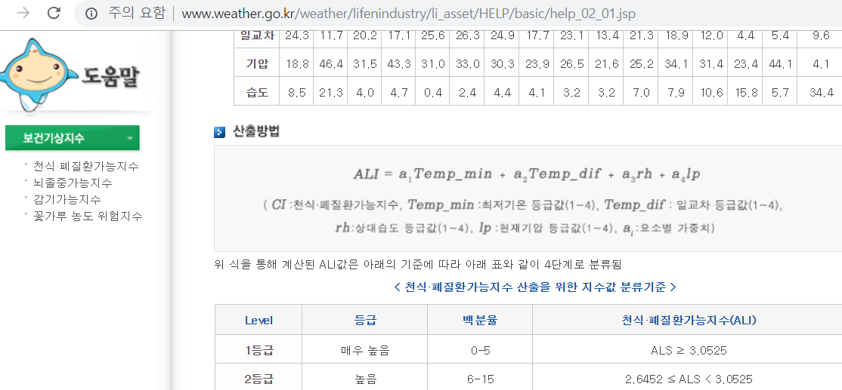
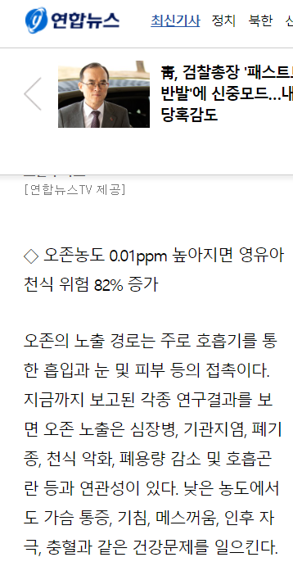
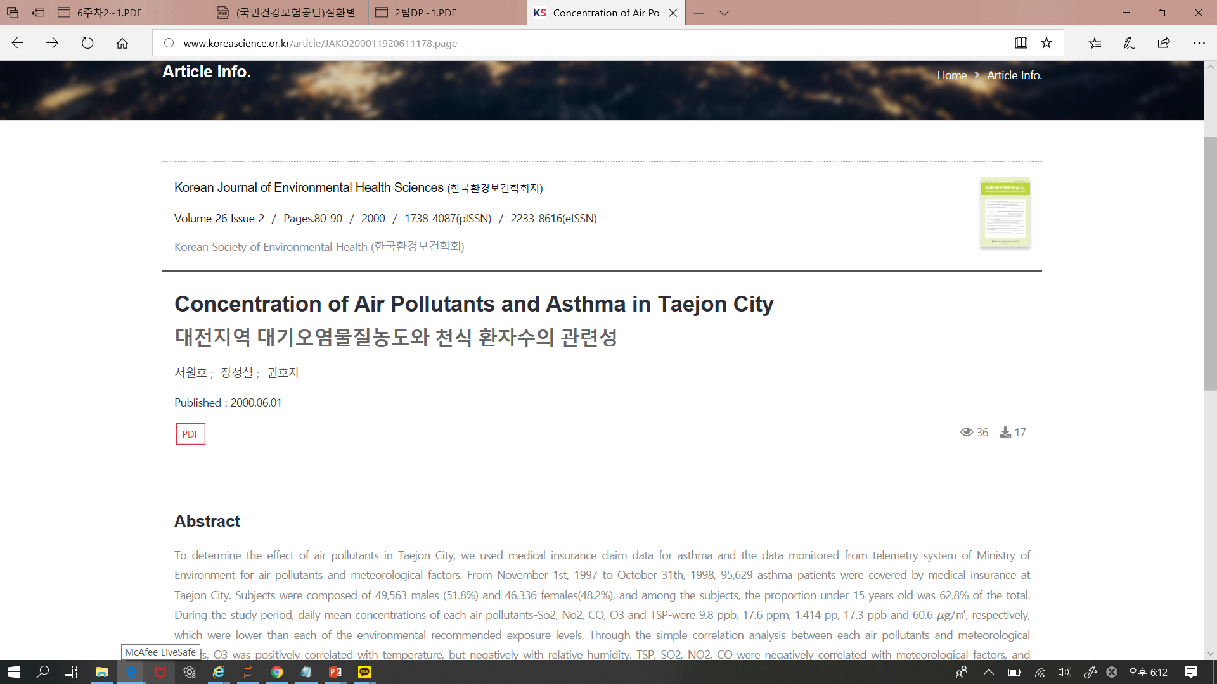
50%
CONTENTS A
Notification of Asthma Risk Index by Region
6-2-1-1)Identify existing predictive formulas
<Existing Calculation Needs>
low temperature
(℃)
daily temperature range
(℃)
Huminity
(%)
barometric pressure
(hPa)
Ozone
(ppm)
http://www.weather.go.kr/weather/lifenindustry/li_asset/HELP/basic/help_02_01.jsp
https://www.yna.co.kr/view/AKR20180601155200017

Slide 18
Notification of Asthma Risk Index by Region
6-2-1-2) standard of asthmatic prediction
ozone concentration (ppm) | the effect on the human body
0.01~0.02 | can smell some.
0.1 | It definitely smells, and it feels irritated in the nose or throat. (If you feel irritation in your nose or throat, your asthma may worsen or you may have a chance of developing it. Increased)
0.2~0.5 | When exposed for three to six hours, the vision is reduced.
A type of photochemical oxidant emitted into the atmosphere that belongs to a secondary pollutant. Repeated exposure can affect the lungs, worsen emphysema and asthma, and reduce lung capacity. In particular, it has many effects on patients with bronchial asthma, respiratory diseases, children and the elderly.
Link :
https://www.airkorea.or.kr/web/airMatter?pMENU_NO=130

Slide 19

50%
CONTENTS A
Notification of Asthma Risk Index by Region
6-2-2) New Asthma Prediction Criteria
low temperature
(℃)
daily temperature range
(℃)
Huminity
(%)
barometric pressure
(hPa)
Ozone
(ppm)
16 regions (daily)
Existing Calculation Needs
New ALI Needs
New ALI(Asthma Risk Index )
16 regions (city and provincial in Korea)

Slide 20
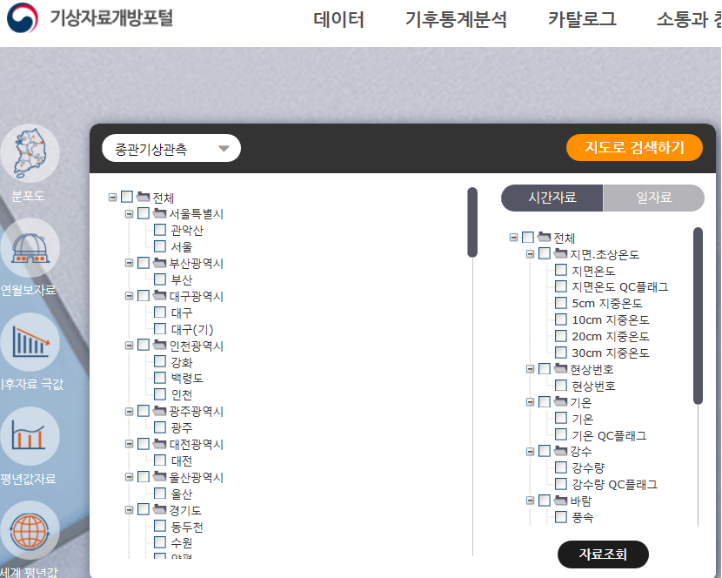
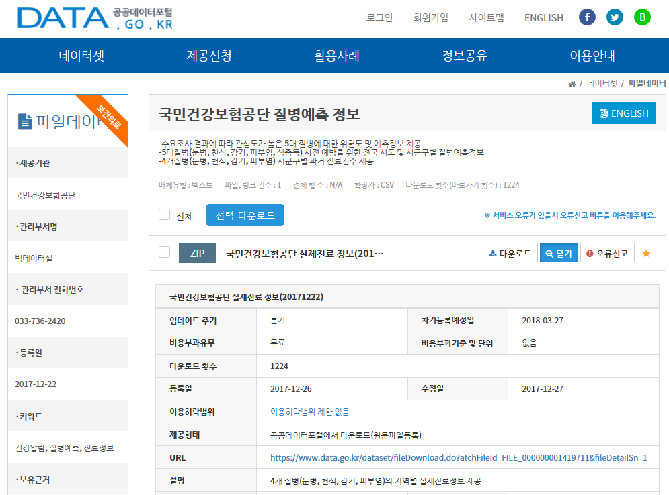
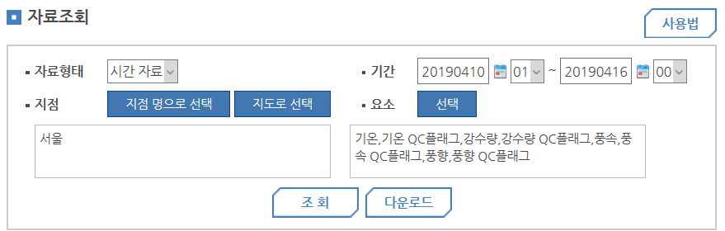
Notification of Asthma Risk Index by Region
6-2-3-1) data collection
The weather service informs the area and the time zone. Easily view and download when you choose what you need
Access file data from the Public Data Portal to select the information you want and download your selections
link : https://data.kma.go.kr/cmmn/main.do
link : https://www.data.go.kr/dataset/15028050/fileData.do

Slide 21
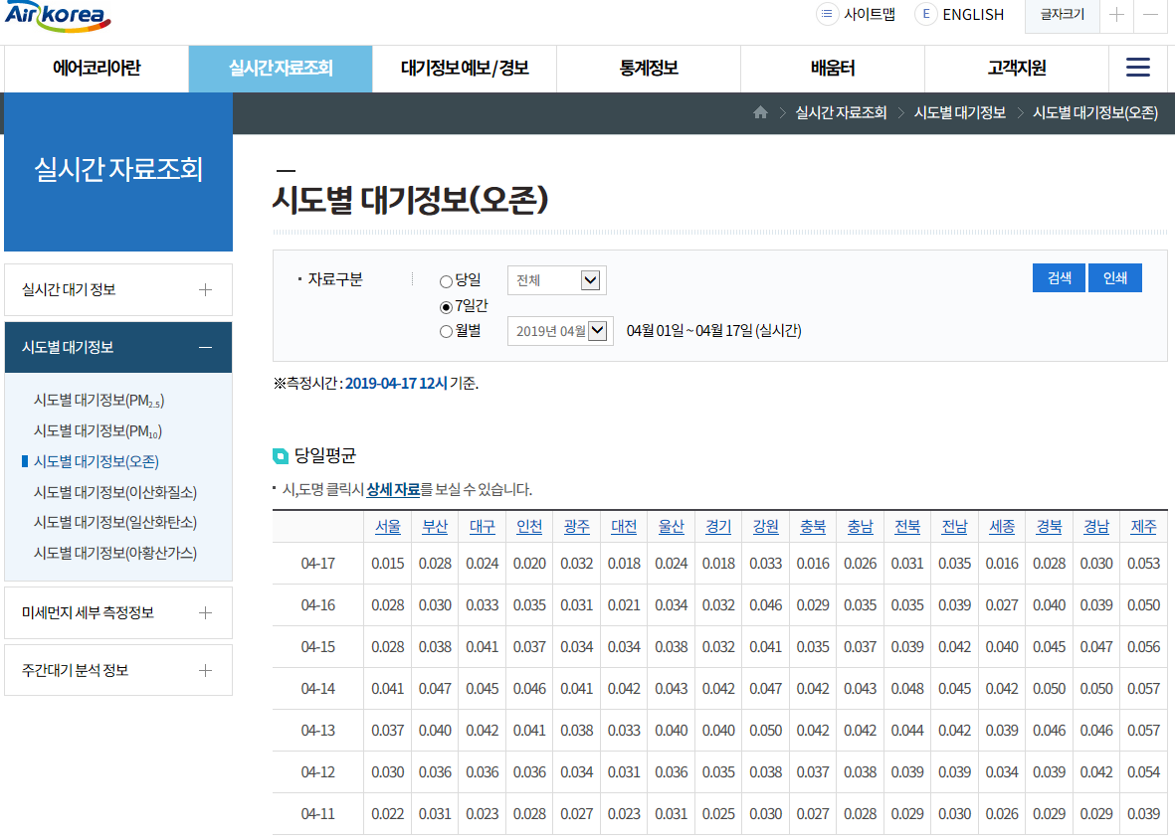
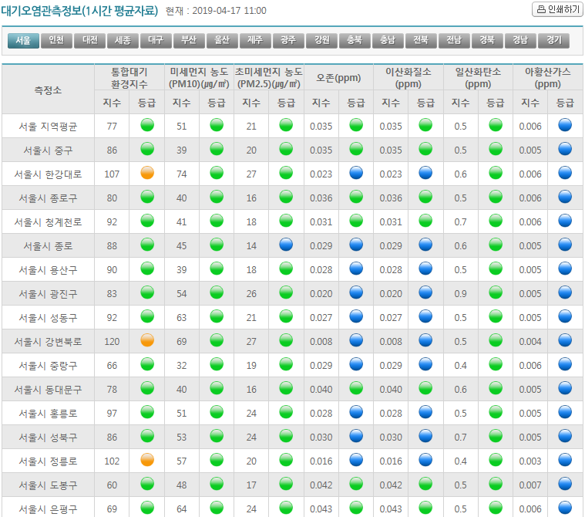
Notification of Asthma Risk Index by Region
6-2-3-2) data collection
In a real-time data query on Air Korea,
Collect atmospheric information by city
Only ozone concentrations required in the 'Caweather' data collection
Air korea link: http://www.kweather.co.kr/air/air_present_me.html
Kweather link : https://www.airkorea.or.kr/web/sidoCompareAir?itemCode=10003&pMENU_NO=103

Slide 22
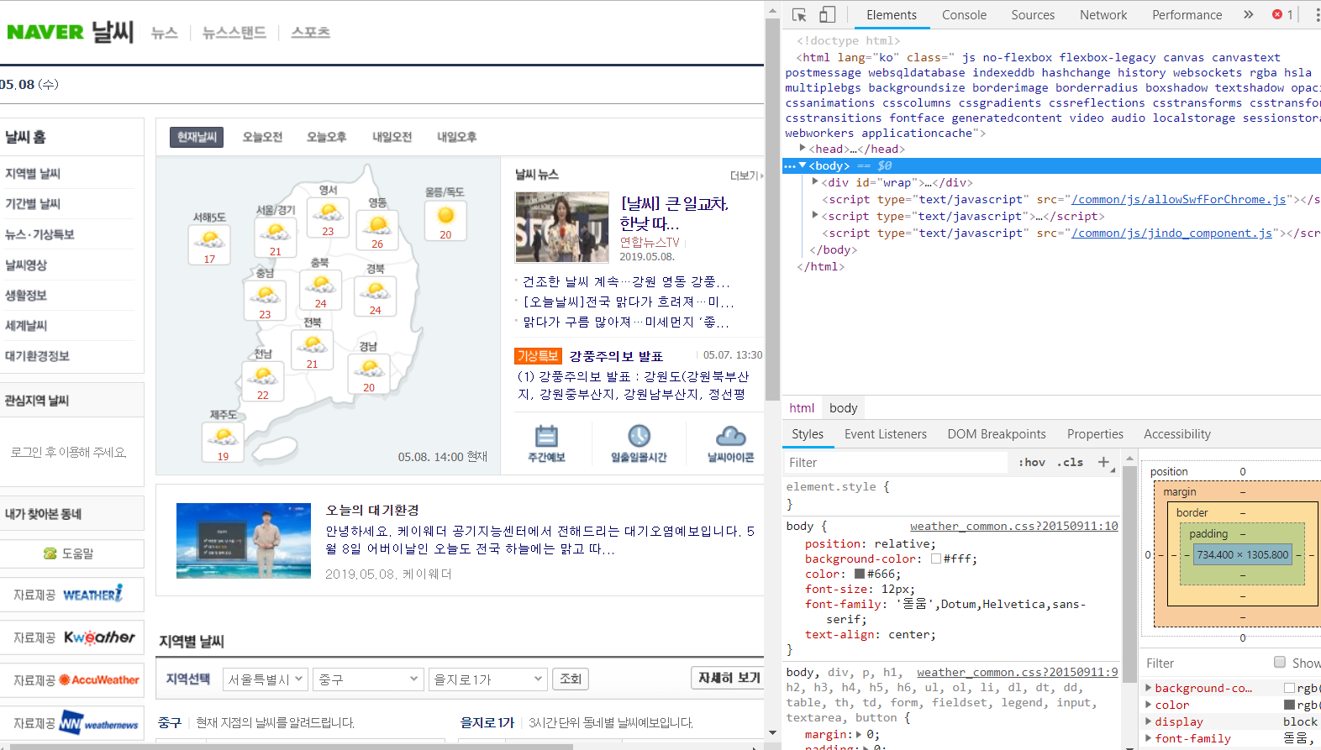
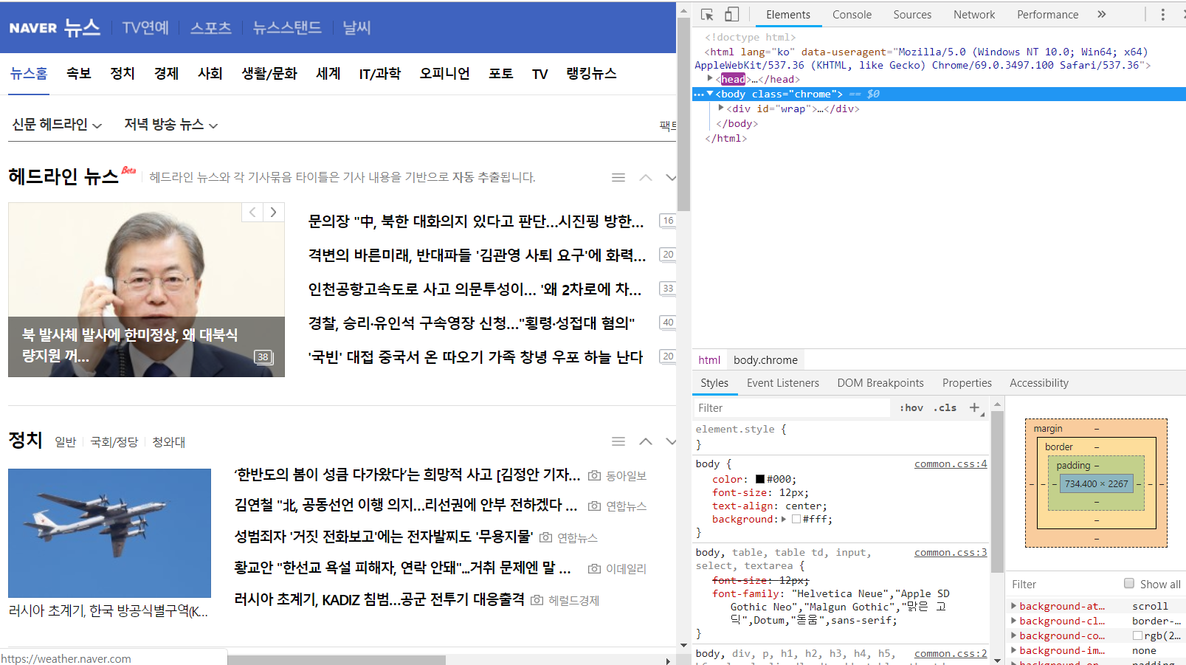
Notification of Asthma Risk Index by Region
6-2-3-3) data collection
Crawling Climate Data in Naver Weather
Crawling Asthma Knight Data on Naver News
link left : weather.naver.com
Link right : news.naver.com

Slide 23
Notification of Asthma Risk Index by Region
6-2-4-1) Analyze asthma data
import pandas as pd
Three representative reasons for using the Pandas module
1. Pandas is a library that provides an essential data structure for data analysis, especially the Pandas DataFrame is most intuitive to handle data with a table-like strainsheet structure!
2. Series and DataFrame in Pandas are data structures that store values equally based on index (index), and misalignment can be prevented in advance and values can be easily accessed based on this.
3. Finally, the biggest feature is supporting relationship operations, such as join, to enjoy the effect of using SQL.
import matplotlib.pyplot as plt
Modular function that lets you draw a graph
%matplotlib inline
A command that lets the results of a graph appear in the output session
import platform
The platform is a system that can run applications, supported by Windows. It's the process of converting to fonts. Without this process, letters would not appear in the form of boxes.

Slide 24
Notification of Asthma Risk Index by Region
6-2-4-2) Analyze asthma data
환자 = pd.read_csv('../play/kisixpa.csv',thousands=',', encoding='euc-kr')
기후 = pd.read_csv('../play/kisixtem.csv',thousands=',', encoding='euc-kr')
오존 = pd.read_csv('../play/sixozon.csv',thousands=',', encoding='euc-kr')
Patient, climate, and ozone data from Gyeonggi Province are imported using the Pandas module.
You can create Thousands according to the way it is stored in the extension and encoding is the same.

Slide 25
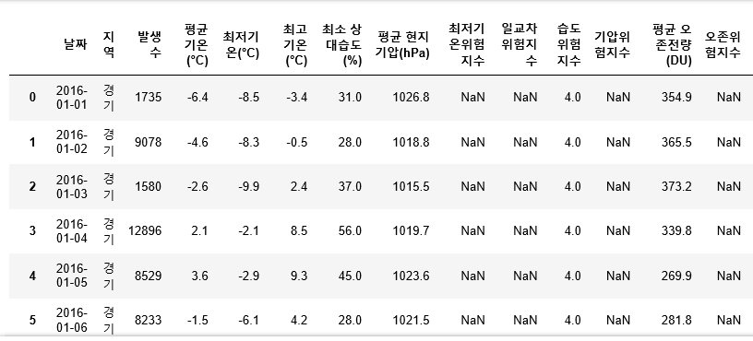
Notification of Asthma Risk Index by Region
6-2-4-3) Analyze asthma data
통합2 = pd.merge(통합, 오존, on='날짜')
We then merged the integrated data with the ozone data by date.
This puts ozone, patients, and climate in one data.

Slide 26
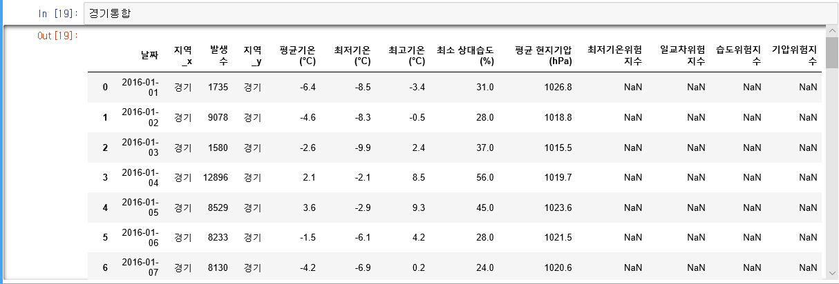
Notification of Asthma Risk Index by Region
6-2-4-4) Analyze asthma data
del 통합['지역_y']
Del is used to remove duplicate region values by writing a command to delete a column.
Then, to change what is called region_x, we used the following command.
통합2.rename(columns={통합2.columns[1] : ＇지역＇},inplace=True)
Rename is a command to reset the name and changed the first column to a region.

Slide 27
Notification of Asthma Risk Index by Region
6-2-4-5) Analyze asthma data
for i in 통합2.index:
if 통합2.values[i,6] >62.5:
통합2['습도위험지수'].values[i] = '1'
elif 62.5<= 통합2.values[i,6] <44.5:
통합2['습도위험지수'].values[i] = '2'
elif 44.5<= 통합2.values[i,6] <30.3:
통합2['습도위험지수'].values[i] = '3'
else:
통합2['습도위험지수'].values[i] = '4'
The following process divides the humidity risk index in Gyeonggi Province by class [i, 6], which means the sixth column. The sixth column, the humidity rating, was divided based on the minimum relative humidity.

Slide 28
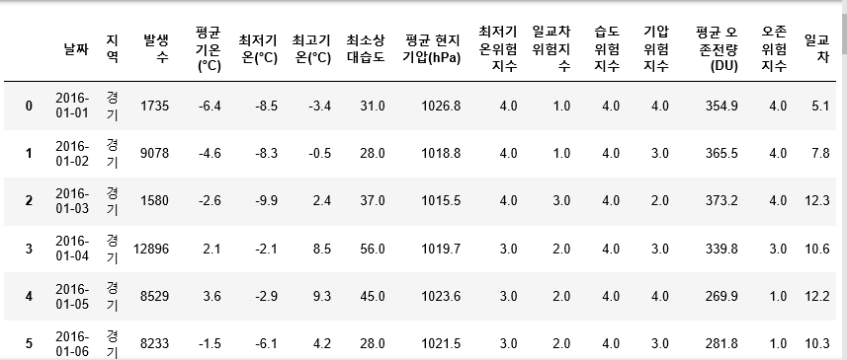
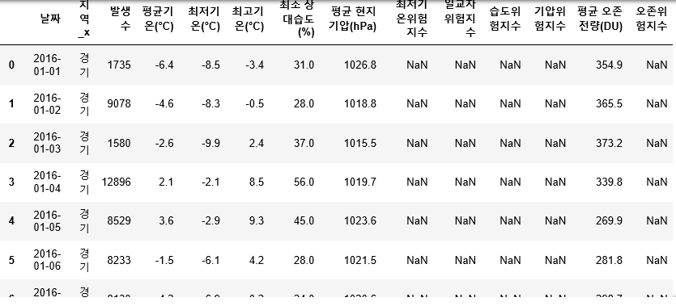
Notification of Asthma Risk Index by Region
6-2-4-6) Analyze asthma data

Slide 29
Notification of Asthma Risk Index by Region
6-2-4-7) Analyze asthma data
일교차 = 통합2['일교차'].corr(통합2['발생수'])
습도 = 통합2['최소상대습도'].corr(통합2['발생수'])
오존 = 통합2[' 오존량'].corr(통합2['발생수'])
기압 = 통합2[＇기압'].corr(통합2['발생수'])
최저기온 = -통합2['최저기온(°C)'].corr(통합2['발생수'])
al = 일교차+습도+오존+기압+최저기온
Following are the number of cases, daily intervals, humidity, ozone, air pressure, and lowest temperature.
Correlation Analysis
What is correlation analysis?
Ex) "A tall foot is big"
-> To analyze the relation between the key and the foot numerically with how much the relation between the key and the foot is related.
상관관계분석이란?
Ex)’키가 크면 발이크다’ -> 키와 발의 관계가 얼마나 관련된 관계를 가지고 수치로 관련성을 분석하는 것

Slide 30
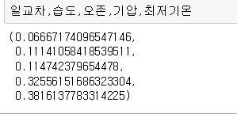
Notification of Asthma Risk Index by Region
6-2-4-8) Analyze asthma data
Next, we divided the daily temperature, humidity, ozone, atmospheric pressure, and the lowest temperature to see which has a great influence on asthma.
Multiply the value by 100 as the reference value of 1.
About 6% of the daily
11% humidity
Oh, John, 12%.
barometric pressure 32%
with a low temperature of 39%.
The lowest temperature has the most effect.
You can check it.

Slide 31
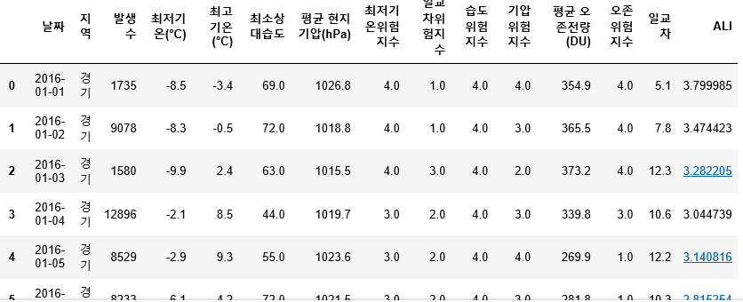
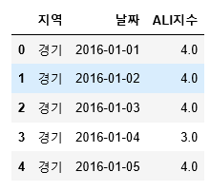
Notification of Asthma Risk Index by Region
6-2-4-9) Analyze asthma data
통합2['ALI'] = float('NaN’)
->command to create an additional column called ALI for Integrated2 data
->Insert 'NaN' as the NaN value (because there is no value) in the added ALI column.
->Fluat can be stored as a decimal value
for i in 통합2.index:
통합2['ALI'].values[i] = 일교차*float(통합2.values[i,8])+습도*float(통합2.values[i,9])+오존*float(통합2.values[i,12])+기압*float(통합2.values[i,10])+ 최저기온*float(통합2.values[i,7])
The ALI value was obtained using the new ALI formula.

Slide 32
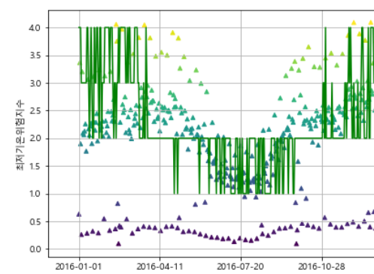
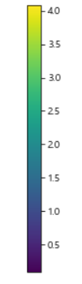
Notification of Asthma Risk Index by Region
6-2-4-10) Analyze asthma data. end
colormap=통합2['환자']
plt.figure(figsize=(16,5))
plt.plot(지수파일['날짜'],지수파일['ALI지수'], color = 'green')
plt.scatter(통합2['날짜'],통합2['환자'],s=20,c=colormap,marker='^')
plt.xticks([0, 100, 200, 300,360])
plt.xlabel('날짜')
plt.ylabel(‘ALI지수')
plt.colorbar()
plt.grid()
plt.show()
New ALI (risk index) and actual asthma cases
Compare to how many matching graphs
ALI지수

Slide 33
Notification of Asthma Risk Index by Region
6-5) Check improvement rate
Ozone, barometric pressure, Huminity,
low temperature, daily temperature range
Ozone, barometric pressure, Huminity, low temperature
경남
0.219
0.193
경북
0.288
0.298
barometric pressure, Huminity,
low temperature, daily temperature range
Ozone, barometric pressure, Huminity, daily temperature range
경남
0.186
0.186
경북
0.285
0.297

Slide 34

Notification of Asthma Risk Index by Region
6-6) Port forwarding

Slide 35


Notification of Asthma Risk Index by Region
6-6) Reasons for web framework selection
Reasons for Flask selection among these three Web frameworks
It's all Python-capable.
Install only the required libraries and packages
It's also possible to build a framework.
It has its own server and php function.
<A typical web framework>
Flask
Django
Tornado
Flask: Micro-Web Framework to Create Web Applications with Python Django: Python Web Framework to Promote Rapid Development and Practical Design Tornado: Python Web Framework and Asynchronous Networking Libraries originally developed
by FriendFeed

Slide 36
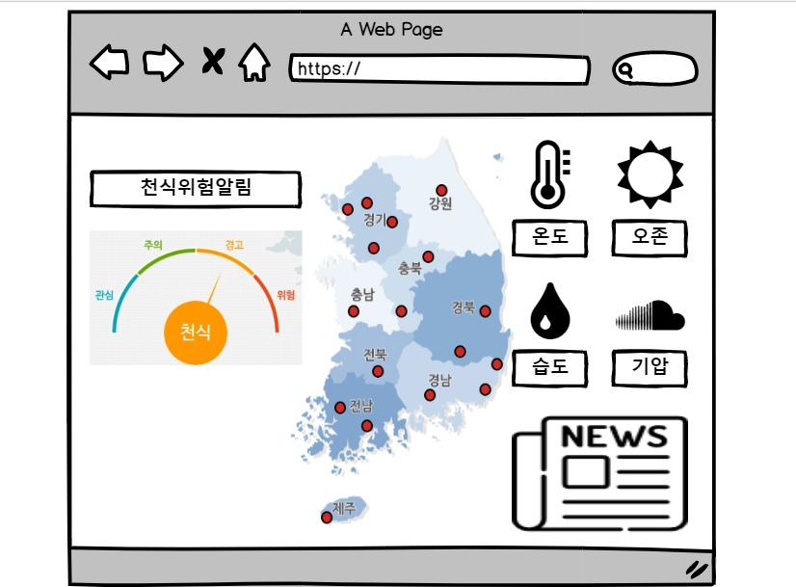
Notification of Asthma Risk Index by Region
6-7) Web page Design Screen

Slide 37
Notification of Asthma Risk Index by Region
6-8-1) Web page development and data collection
#the function of bringing in seeds today.
def humiPha():
global geome #Variables with local name
url = "http://www.weather.go.kr/weather/observation/currentweather.jsp"
html = urlopen(url)
bs_obj = bs4.BeautifulSoup(html.read(), "html.parser")
find1=bs_obj.find("div",class_="width2")
find2= find1.find("div",id="content_weather")
find3 = find2.find("table",class_="table_develop3")
In today's weather table div for the URL,
Find your own class name.
Find function found
The name of that unique ID or class
the humidity and air pressure of the day
to be found.
Find where the numbers are coming from

Slide 38
Notification of Asthma Risk Index by Region
6-8-2) Web page development and data storage
#connection Database
conn = pymysql.connect(host='localhost', port = 8808, user='root', password=pas, db='webdb', charset='utf8')
def random_news():
try:
#Insert conn.cursor() function into curs
with conn.cursor() as curs:
#Delete all contents in table sql statement
delsql = 'delete from view_news'
curs.execute(delsql)
#Data below for variable sql #today_news with sql statements to count how manyt
sql = "select MAX(id) from today_news“
#values(%s, %s, %s, %s, %s, %s) I will put six data into this DB. #(id, today, href, title, live, star)
sql1 = 'insert into view_news values(%s,%s, %s, %s, %s, %s, %s)‘
# The errors when it does, is as follows. # execute writing (" set type, " + names) written on it in you....
curs.execute("set names utf8")
curs.execute(sql)
# Confirm the insertion.
#You can't save it if you don't.conn.commit()
finally:
#End connection.
conn.close()

Slide 39
Notification of Asthma Risk Index by Region
6-8-4) Web Page Development
How to connect to this HTML and where to set up your mailing address, depending on what you put in the methods.
@main.route('/', methods=['POST', 'GET'])
def index () :
db_class = dbModule.Database ()
sql = " select * from webdb.danger_rank “
sql4 = " select * from webdb.today_news "
row1 = db_class.executeAll (sql)
row3 = db_class.executeAll (sql4)
# HTML data resultData, which sends parameters to a folder called template.
return render_template ( ' /main.html ' ,
resultData = row1 [ 0 ],
today_news = row3)
The local risk rating index and the news table.
Put each in a variable and send it to html.

Slide 40
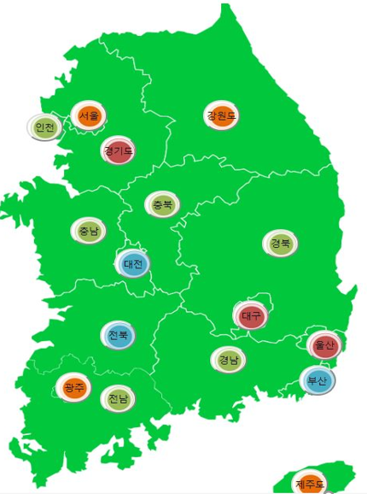
Notification of Asthma Risk Index by Region
6-8-5) Web Page Development
<span class ="num1">
<input type="submit" title ="강원도" value="강원도" id="crd1" for={{resultData.강원도}}>
<input type="submit" title="경북" value="경북" id="crd2" for ={{resultData.경북}}>
<input type="submit" title="경기도" value="경기도" id="crd3" for ={{resultData.경기도}}>
<input type="submit" title="서울" value="서울" id="crd4" for ={{resultData.서울}}>
The variables you sent me above are in the
This is the contents of html.

Slide 41
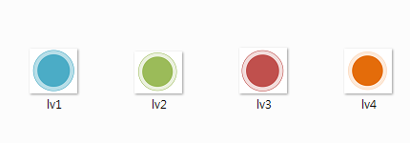
Notification of Asthma Risk Index by Region
6-8-6) Web Page Development
.num1>input[for='1']{position:absolute;width: 50px; height:47px;;background:url(lv1.png); border-radius : 100%}
.num1>input[for='2']{position:absolute;width: 50px; height:44px;;background:url(lv2.png); border-radius : 100%}
.num1>input[for='3']{position:absolute;width: 50px; height:48px;;background:url(lv3.png); border-radius : 100%}
.num1>input[for='4']{position:absolute;width: 50px; height:47px;;background:url(lv4.png); border-radius : 100%}
Css content that changes the image for
each value of For.
Color changes based on data values received by grade 4 image in Png format

Slide 42
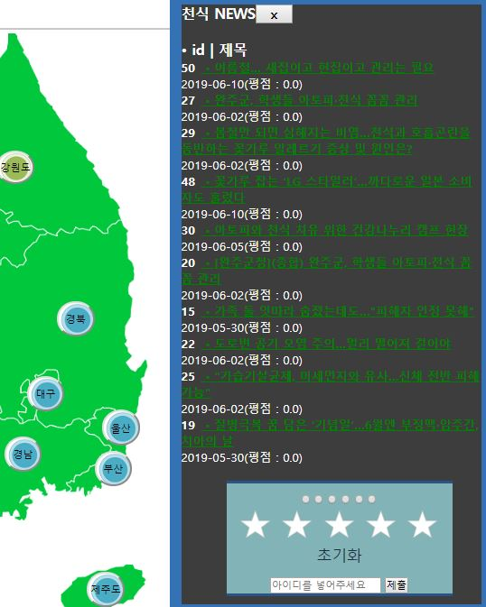
Notification of Asthma Risk Index by Region
6-9-1) star score function
Post is suitable for sending large amounts of data and submit using form.
< form id = " star " action = " http : // localhost : 9000 " method = " POST " >
#Command statements for sending star data to a location you specify
#when you receive an asterisk
< input type = " radio " name = " stars " id = " star-null " value = " 0 " >
< input type = " radio " name = " stars " id = " star-1 " value = " 1 " >
…
< input type = " radio " name = " stars " id = " star-5 " value = " 5 " >
< section >
< label for = " star-1 " >
< svg width = " 255 " height = " 240 " viewBox = " 0 0 51 48 " >
</ section >
< p > < input type = " text " name = " title " placeholder = " name " >
< input type = " submit " > </ p >
</ form >
Placeholder can insert a notice into an input element or textarea element
The GET is sent in pairs with the value in the address line and the POST is hidden (in the body). That is,
http://url/bbslist.html?id=5&pagenum=2
is a GET format and POST is a form of submit.
Post
Supplementary
explanation

Slide 43
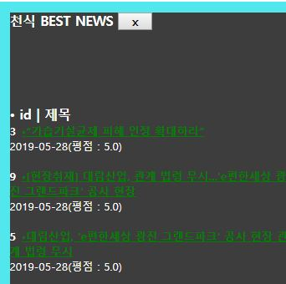
Notification of Asthma Risk Index by Region
6-9-2) best news function
sql2 = 'select*from today_news order by starset desc‘
curs.execute(sql2)
#Choose the highest number of stars in the list.
for i in range(0, 3):
#These are the contents that will go into today (date), links, titles, and stars in
#%s in order to execute.
curs.execute(sql1, (news_date[i][0], news_date[i][1], news_date[i][2], news_date[i][3], news_date[i][7]))
j= j+1

Slide 44
Notification of Asthma Risk Index by Region
6-10-1) Automatic Processing via Scheduler
#Using Scheduler Module
if __name__ == "__main__":
sched = BackgroundScheduler()
# BackgroundScheduler() Use for multiple actions
sched.start()
#Using the scheduler #Enables the function allstart in 5 minutes every hour. #You can include the function name in the function section, but not in the format allstat (1, 2). #In case you want to enter a function, make a function separately and execute the function to use the contents. Enter a function.
sched.add_job(allstart, 'cron', minute="05", second='00', id="Today")
#Daemon booking process, Iran cron can visual instruction to be carried out on Task Scheduler. # still necessary to get back without stopping ' while ' loops for iteration....
while True:
time.sleep(60)

Slide 45
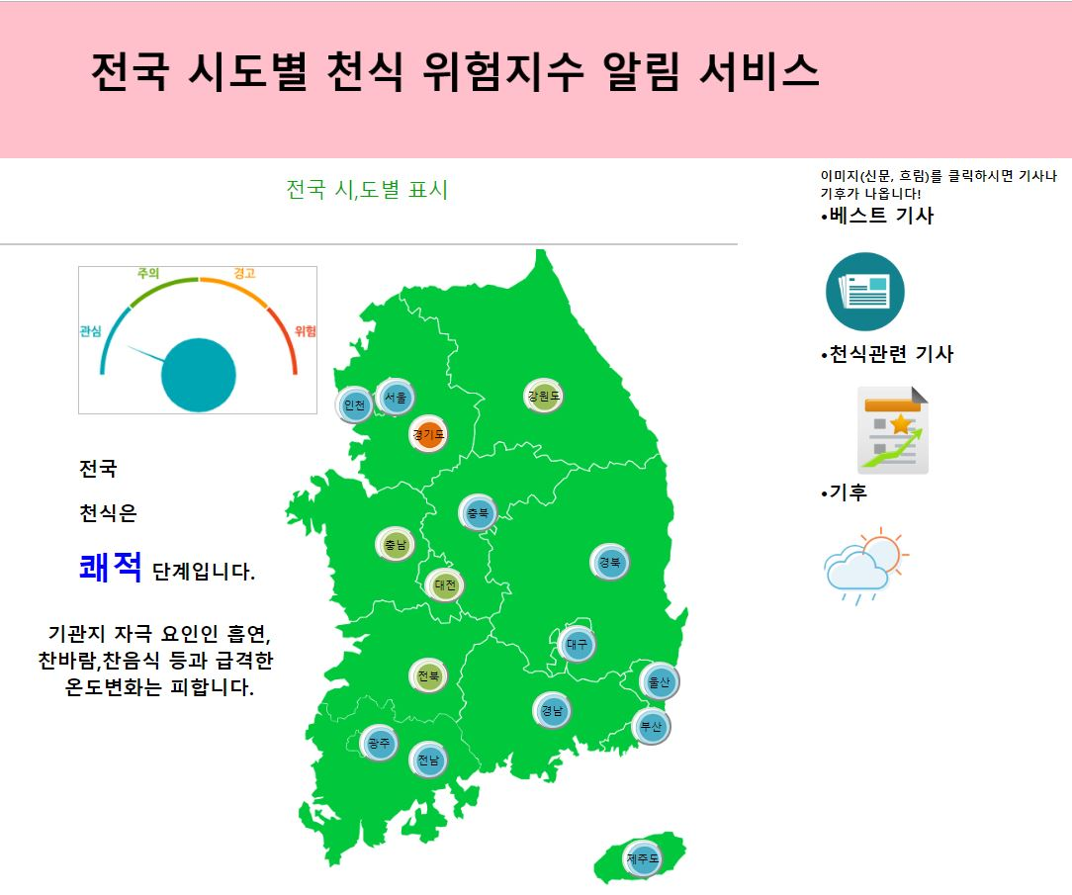
Notification of Asthma Risk Index by Region
Final view of the project

Slide 46
Notification of Asthma Risk Index by Region
7) Execution video

Slide 47

Thank you

Slide 48
Notification of Asthma Risk Index by Region
8-1) Execution Schedule
 | 1week | 2week | 3week | 4week | 5week | 6week | 7week | 8week | 9week | 10week | 11week | 12week | 13week | 14week | 15week
Planning
Data survey
Data Analysis
DB Storage
Web. build
Web Connection
test

Slide 49


Notification of Asthma Risk Index by Region
9. References literature and site
Python Development References literature
Mysql and php References literature
1.파이썬으로 데이터 주무르기
2. Php + mysql 웹 개발 마스터북
Notes:
추천이유
저자가 엔시소프트에서 근무 경험을 바탕으로 적어 하둡을 사용하는데 있어 핵심정리를 잘하였다.
다양한 샘플 코드와 실행 결과를 넣어 다른 Sql과 달리 글을 많이 줄이고 실습을 강조하여 지필을 하였다.
초보자 다음단계 중급자 단계가 배우는 단계로 MySQL 연결도 가능하다.

Slide 50
Notification of Asthma Risk Index by Region
9. References literature and site
http://www.mohw.go.kr/react/index.jsp //보건복지부
http://www.airkorea.or.kr/index // 에어코리아(한국 지도사진 참조)
https://data.kma.go.kr/data/grnd/selectAsosRltmList.do?pgmNo=36 기상청(자료포탈 사이트)
https://www.sedaily.com/NewsView/1OIBYC9Z3R Ozone Risk and Wind Velocity
https://terms.naver.com/entry.nhn?docId=3389438&cid=47340&categoryId=47340 Appropriate Humidity Related
http://forecast.nhis.or.kr/menu.do References site(국민 건강알림 서비스)
https://www.yna.co.kr/view/AKR20180601155200017 asthmatic and ozone-related news (연합뉴스)

Slide 51
Notification of Asthma Risk Index by Region
10. References
팀 프로젝트 저장소
https://github.com/allnight5/D.Pteam
조원 별 깃 허브 링크

Slide 52
Q&A
Questions and Answers

